Slide 1
Case Study 9: Blunt Abdominal Trauma
Questions & Answers

Slide 2
Question 1
What are the initial assessment priorities for a patient with blunt abdominal trauma?

Slide 3
Answer:
Always remember your A, B, C priorities. For trauma, here is a good way to remember your primary survey priorities:
Airway- Is the patient’s airway open?
Breathing- Are respirations effective? Does the patient require assistance or ventilation?
Circulation- Monitor for signs of hypovolemic shock as these patients are high risk.
Disability- Perform a quick neuro assessment as well as LOC and motor function evaluations.
Exposure and Evacuation- Undress patient to see injuries, consider transport if necessary.
Question 1
(Wagner, 2010)

Slide 4
Question 2
Explain the initial alterations in hemodynamic values presented.
Describe the stages of
hypovolemic shock.
What stage is he in?
What treatment should be provided?

Slide 5
Answer:
Stages of Hypovolemic Shock:
Stage I- Up to 15% of the circulating volume, or approximately 750 mL of blood, is lost. These patients often exhibit few symptoms because compensatory mechanisms support bodily functions.
Stage II- When 15% to 30%, or up to 1,500 mL of blood, of the circulating volume is lost. These patients have subtle signs of shock, but vital signs usually remain normal.
Stage III- when 30% to 40% of the circulating volume, or from 1,500 to 2,000 mL of blood, is lost. This patient looks acutely ill.
Stage IV- Loss of more than 40% of circulating volume, or least 2,000 mL of blood. Patient is at risk for exsanguination.
Treatment priority is fluid replacement and RBC if necessary.
Question 2
(Unbound Medicine, 2011)

Slide 6
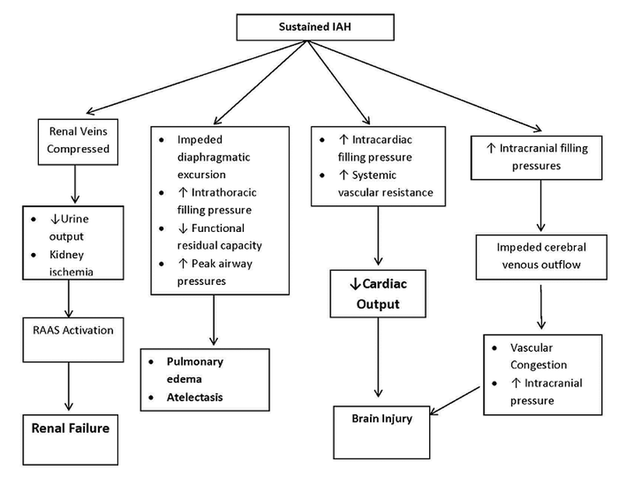
Question 2
Malik, T. (2013) Adapted from various sources

Slide 7
Question 3
What diagnostic tests are done to evaluate and treat patients who have sustained a blunt abdominal trauma?

Slide 8
Answer:
Arterial Blood Gases
Complete Blood Count
Hemodynamic Parameters: cardiac output and cardiac index, oxygen delivery, oxygen consumption, central venous pressure, pulmonary capillary wedge pressure, and systemic vascular resistance
Blood Lactate Level
Hemoglobin & Hematocrit
Urinary Bladder Pressure Measurement
Radiographic and imaging studies are important depending on the location of interest and might include chest and abdominal x-rays, transesophageal echocardiography, aortography, computed tomography, magnetic resonance imaging, or focused abdominal sonography for trauma.
Question 3

Slide 9
Question 4
What are the management guidelines for a patient with blunt abdominal trauma?

Slide 10
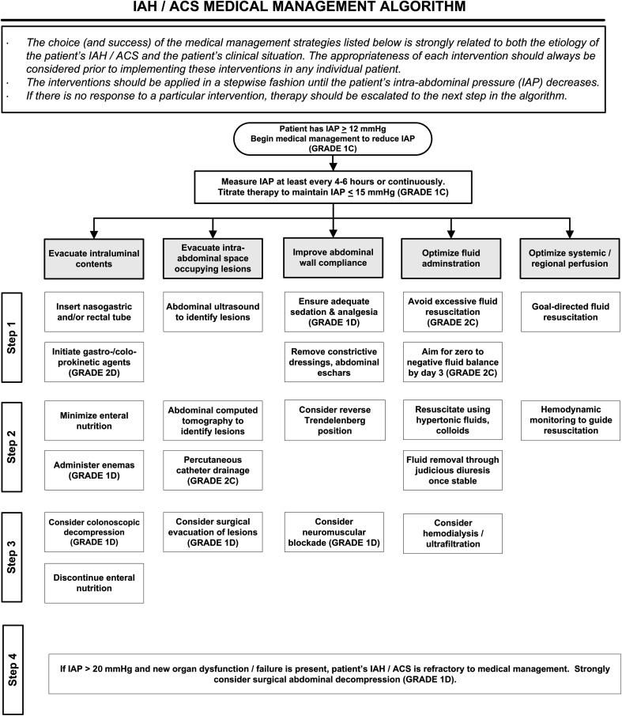
Answer:
(Kirkpatrick, 2013)
Question 4

Slide 11
Question 5
What is meant by abdominal compartment syndrome/ intra-abdominal hypertension?

Slide 12
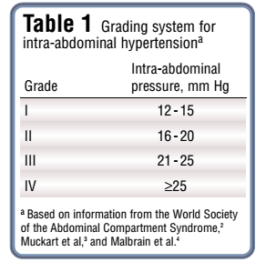
Answer:
The pressure within the abdominal cavity, or intra-abdominal pressure in a normal person is 0-5 mmHg. Various factors, including blunt trauma can lead to increased abdominal pressure or intra-abdominal hypertension which is defined as sustained pressures over 12 mmHg (Lee, 2012).
If untreated, high pressures are sustained and the illness progresses to Abdominal Compartment Syndrome (ACS).
ACS is defined by the World Society of Abdominal Compartment Syndrome as a sustained intra-abdominal pressure (IAP) of > 20 mmHg (with or without an abdominal perfusion pressure (APP) < 60 mmHg) that is associated with new organ dysfunction/failure (Cheatham, M.L., 2009).
Question 5

Slide 13
Question 6
What is a pulmonary contusion?
What other factors may be contributing to Mr. Reynold’s poor oxygenation status?

Slide 14
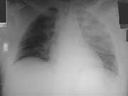
Answer:
A pulmonary contusion is an injury to the lung without laceration that may not be visible on X-ray for up to 48 hours (trauma.org, 2004).
Contributing factors for poor oxygenation:
Shallow, short breaths (due to contusions)
Increased abdominal pressure (reduced lung compliance)
Poor cardiac output
Increasing systemic vascular resistance
Question 6

Slide 15
Question 7
What are the nutritional needs of a patient with a blunt abdominal trauma?
What type and when
should feeding be started?
What complications should the nurse be concerned with at each stage of recovery?

Slide 16
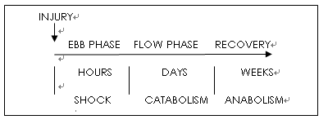
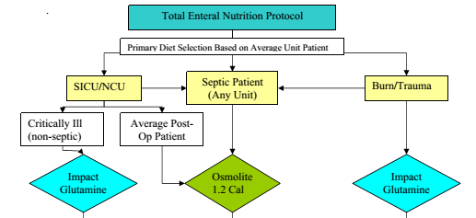
Answer:
Feeding should be started as soon as possible following trauma. The patient will move from the Ebb phase (hypometabolism) to the Flow phase (hypermetabolism) and will require additional nutrients as they heal.
Patients are at risk for amino acid and electrolyte deficiencies (Wagner, 2010).
www.jspen.jp
Institutional guidelines should be followed.
Feeding protocol from Vanderbilt University Medical Center (Diaz, 2004)
The formula used in this case study is Perative. Here is more information about that formula specifically: http://abbottnutrition.com/brands/products/perative
Question 7

Slide 17
Cheatham, M. L. (2009). Abdominal compartment syndrome: pathophysiology and definitions. [Review]. Scand J Trauma Resusc Emerg Med, 17, 10. doi: 10.1186/1757-7241-17-10.
Diaz, J. (2004). Critical Care Nutrition Practice Guidelines- Vanderbilt University Medical Center. Retreived from www.mc.vanderbilt.edu
/surgery/trauma/Protocols/nutrition-protocol.pdf
Kirkpatrick, AW, Roberts DJ, De Waele J, Jaeschke R, Malbrain ML … Olvera C. (2013). Intra-abdominal hypertension and the abdominal compartment syndrome: updated consensus definitions and clinical practice guidelines from the World Society of the Abdominal Compartment Syndrome. Intensive Care Medicine. 39(7):1190-206. doi: 10.1007/s00134-013-2906-z
Lee, R. (2012). Intra-abdominal Hypertension and Abdominal Compartment
Syndrome: A Comprehensive Overview. Critical Care Nurse 32 (1):19-31. Retrieved from www.aacn.org/wd/Cetests/media/C1212.pdf
Trauma.org. (2004, February). Chest trauma: Pulmonary contusion. Retrieved from http://www.trauma.org/archive/thoracic/CHESTcontusion.html
Unbound Medicine. (2011). Hypovolemic/Hemorrhagic Shock. Retrieved from http://nursing.unboundmedicine.com/nursingcentral/ub/view/Diseas es- and-Disorders/73631/0/hypovolemic_hemorrhagic_shock
Wagner, K. D., Johnson, K.L., Hardin-Pierce, M. G. (2010). High-acuity nursing (5th ed.). Saddle River, NJ: Pearson Education Inc.
References

